Slide 1
Wave density/flux in neural columns
Vincent Baker
Drexel University Department of Physics

Slide 2
Wave Structures
Previous work has demonstrated the existence of both traveling and standing wave structures in various areas of the brain
Previous simulation efforts have studied traveling waves in a 2-D planar neural networks with local connectivity
We observe traveling waves in “1-D” neural columns with local connectivity and random stimulus
2-D phase diagram: (flux, width, firing regularity) and speed versus speed constant and connectivity constant
Go to four column ensemble
We are interested in characterizing these waves and understanding how the neural column topology and dynamics change the wave behavior
Do we observe traveling waves at all?
How dense are the waves?
“Flux”
Wave firings versus total firings
Wave “thickness” or “wave packet height” or sigma? Plot histogram of a time interval
How regular are the waves? Histogram of start times
How fast do the waves travel?
What happens when waves collide?
How does the column topology and neuron characteristics change the wave behavior?

Slide 3
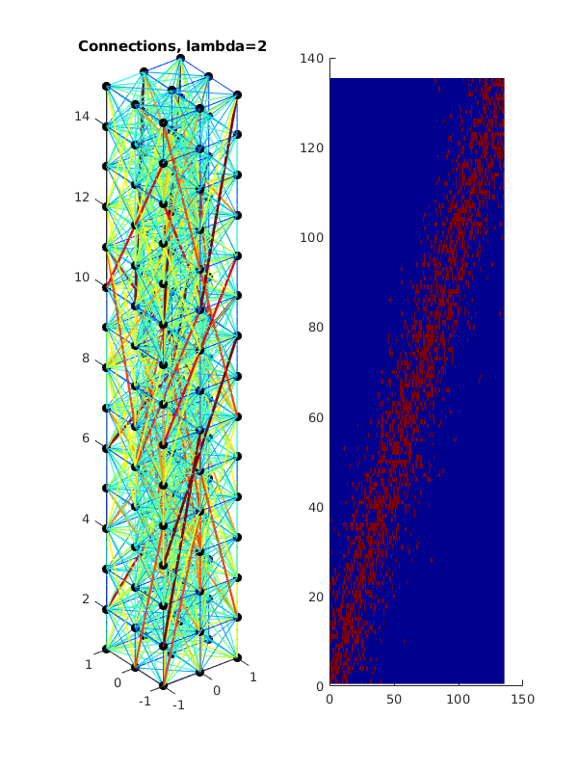
Column structure
Neurons on a unit spacing
Column topology defined by x-y cross section and z height, waves travel along z axis
Neurons are connected probabilistically using distance model with exponential decay, high local connectivity with sparse long-distance connectivity
Z axis
3x3x15 column

Slide 4
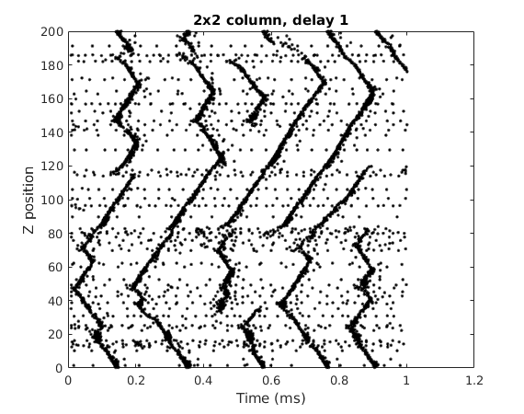
Example waves
We plot the neuron firings over time, with one black mark per firing event
We plot each neuron firing at the Z position of the neuron. There are multiple neurons at each Z position so there can be overlapping marks
Wave collision and annihilation
Background firing activity defined as firing events that are not part of a wave structure
Traveling wave initiation
Is wave regularity set by specific groups of neurons?
Run same column with different stimulus.
Question: Is there a group of neurons that fire regularly?

Slide 5
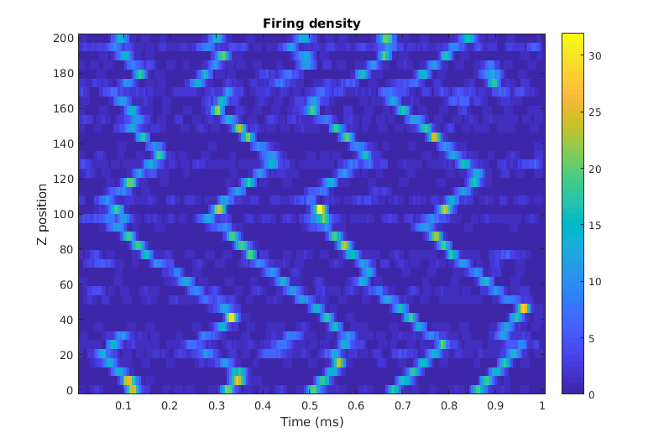
Wave Density
Plot density (histogram) over time (5 ms step, 10 ms window)
We observe variation in the firing density during wave propagation

Slide 6
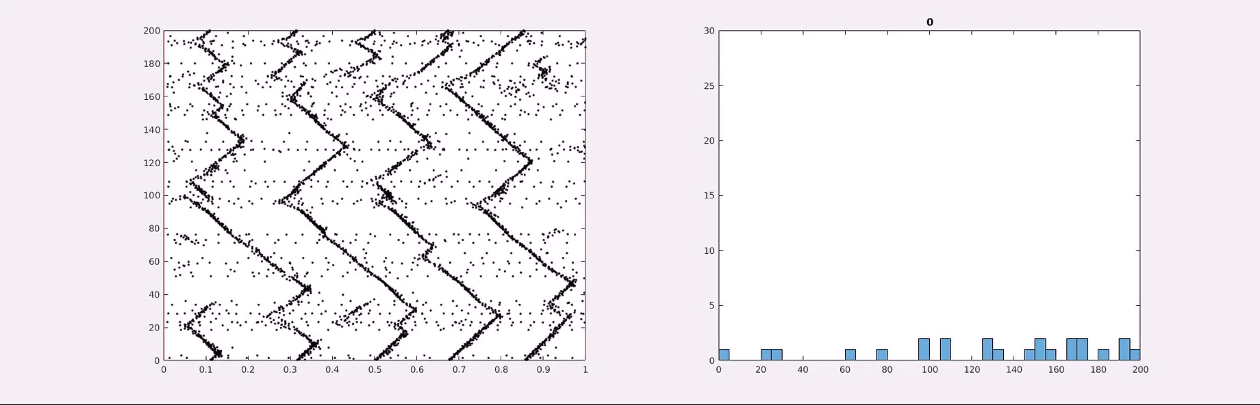
Wave animation

Slide 7
Notes
Stim at bottom for controlled waves
Global histogram, try several bin sizes, look for regions of high/low activity
If so, look for correlation in wave initiation sites with background stimulus
Then move on to characterization (speed, density) versus (speed constant, connectivity) before micro analysis
Micro analysis:
Connectivity or neuron parameters explain firing sites
“Echo”

